Slide 1
AI Platform Strategy
Plan Today for better tomorrow

Slide 2
AGENDA
NORTH STAR
AI Platform Overview
Modular / Resilient AI Platform
Data Overview
Data 2 Value Architecture
Data: Secure, Governed, Compliant Foundation
Realistic Market
Summary
Executable Playbook
Outcome driven Playbook
Value Map
North Star
Realistic Market
Summary

Slide 3
ORGANIZATIONAL AI PLATFORM NORTH STAR (6 months, incl. current quarter)
Teams:
Enable teams to accelerate product innovation
Organization:
Drive Innovation at faster pace
Value:
Unlock significant business value
Revenue:
Accelerate existing revenue growth
Create new revenue growth

Slide 4
NORTH STAR - INTERNAL
Eco-System:
Ecosystem that balances centralized governance with decentralized innovation
Outcome:
Each team can safely build, evaluate, and ship domain-specific agents on their own data with gated promotion from dev → stage → prod.
Guardrails:
Zero-trust access; data contracts; immutable lineage; automatic evals; cost & drift controls; red/blue-team tests before prod.
Compliance posture

Slide 5
Business Value
Self-Serve Acceleration: Each team can spin up agents in weeks, not months.
Risk Reduction: Regulatory alignment, safe defaults, audits.
Resilience: Modular services; failover and cost governance.
Measurable Impact: KPIs (agent adoption, accuracy, cost per query, drift rate).

Slide 6
Platform: Modular, Resilient AI Management Layer
Identity & Access
Single Sign-On + MFA.
Attribute-based access control (ABAC):
Enforce who can use which data and tools.
Shared Services
Vector Store per team (isolated indexes).
Feature Store per team (reusable ML features).
Secrets Vault with per-team paths.
Agent Fabric
Runtime container for team agents.
Toolkits: retrieval, SQL, APIs, Slack/Jira, code execution (sandboxed).
Built-in guardrails: prompt filtering, content policies, jailbreak detection.
Lifecycle Management
Model/Agent Registry: version datasets, prompts, tools, and agents.
Deployment Gates: Dev → Stage → Prod requires passing evaluations.
CI/CD Pipelines: signed artifacts, reproducible builds, rollback.

Slide 7
Platform: Modular, Resilient AI Management Layer
Compliance Layer
NIST AI RMF for governance.
ISO/IEC 42001 AI Management System integration.
EU AI Act alignment: DPIAs, human oversight, risk classification.
Observability
Unified logging, traces, and cost dashboards.
Drift detection, accuracy monitoring, error budget policies.

Slide 8
Agents: Per-Team, Isolated, Governed Autonomy
Team Workspaces
Each team gets a workspace (IAM group, namespace, secrets, budget).
Boundaries: network (VPC/NSG), identity, and KMS keys.
Data Access
Teams query only their marts, features, and vectors.
Compliance labels enforce allowed datasets (no accidental cross-team leaks).
Agent Runtime
Each agent project bundles:
Data sources (curated marts, vectors).
Approved tools (team-specific).
Guardrails (input/output filters, SLOs).
Cost budgets & rate limits.

Slide 9
Agents: Per-Team, Isolated, Governed Autonomy
Evaluation Harness
Golden question sets, regression tests.
Red-team scenarios (prompt injection, hallucination).
Auto block promotion if evals regress.
Deployment Lifecycle
Dev sandbox (low-risk experiments).
Stage (with golden set evaluations).
Prod (audited, monitored, signed off).
Human Oversight
For sensitive/high-risk use cases: manual approval, DPIA, escalation.

Slide 10
Business Value
Self-Serve Acceleration: Each team can spin up agents in weeks, not months.
Risk Reduction: Regulatory alignment, safe defaults, audits.
Resilience: Modular services; failover and cost governance.
Measurable Impact: KPIs (agent adoption, accuracy, cost per query, drift rate).

Slide 11
Data: Secure, Governed, Compliant Foundation
Outcome: Each team can safely build, evaluate, and ship domain-specific agents on their own data with gated promotion from dev → stage → prod.
Guardrails: Zero-trust access; data contracts; immutable lineage; automatic evals; cost & drift controls; red/blue-team tests before prod.

Slide 12
DATA PLATFORM
Combining functionality and user-friendliness, we empower users to streamline operations and boost efficiency

Slide 13
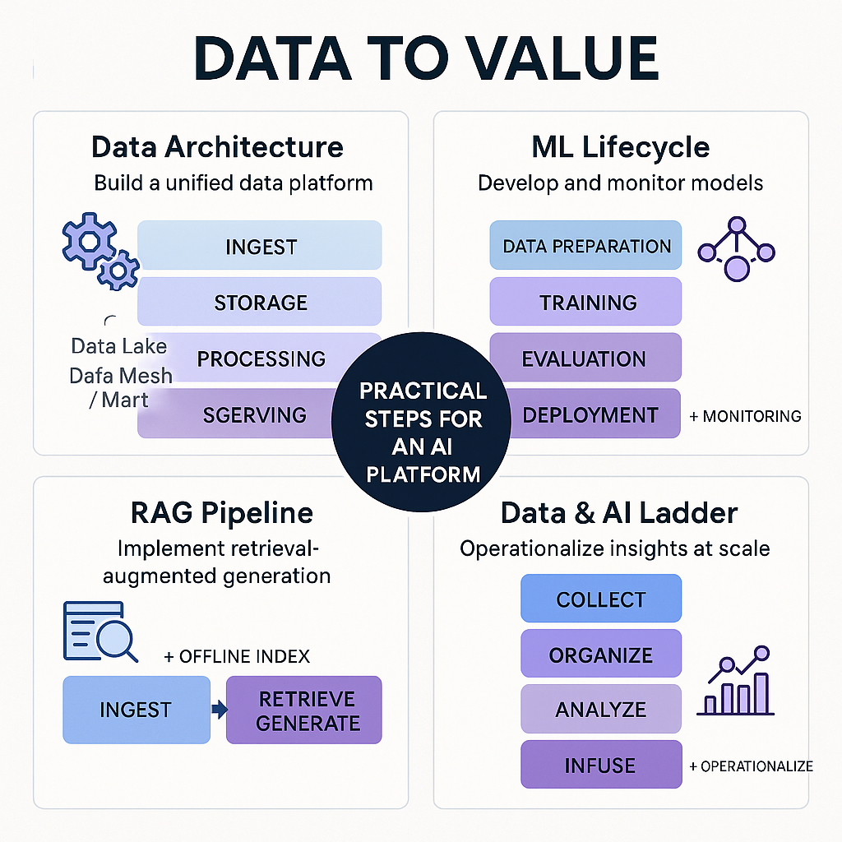
Data Strategy Platform Overview

Slide 14
Data: Secure, Governed, Compliant Foundation
Outcome: Each team can safely build, evaluate, and ship domain-specific agents on their own data with gated promotion from dev → stage → prod.
Guardrails: Zero-trust access; data contracts; immutable lineage; automatic evals; cost & drift controls; red/blue-team tests before prod.

Slide 15
AI PLATFORM
Platform + Agents framework

Slide 16
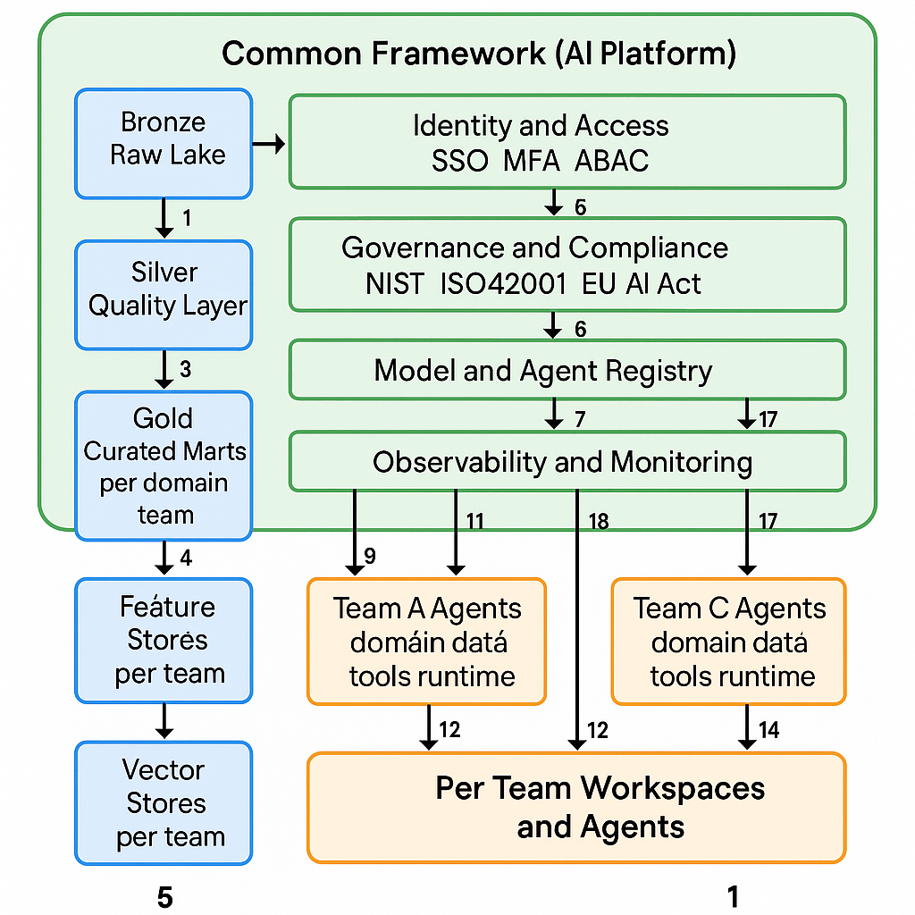
Platform Overview

Slide 17
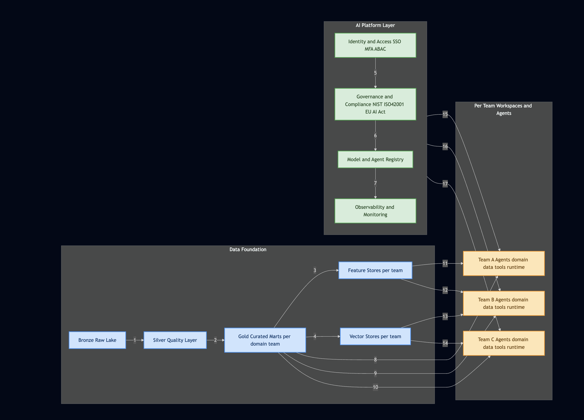
AI Platform Overview

Slide 18
Architecture: Platform + Agents
The architecture is a hub-and-spoke model
Maximum efficiency, resilience and Seamless integration
Core AI platform serves as our centralized "engine," providing shared services and ensuring security and compliance
Autonomous AI agents,
Built by individual teams
”Catalysts" for creating direct business value

Slide 19
The Autonomous AI Agents (The Spokes)
These are the direct drivers of business value. Each agent is a modular, domain-specific application that is owned and developed by a specific business unit.
Modular & Agile: Each agent is a self-contained unit built to solve a specific business problem, such as personalizing customer experiences to increase sales or automating support to reduce costs. This modularity allows for rapid development and deployment.
Resilient & Independent: Agents are designed to operate independently. This ensures that the failure of one agent does not impact the entire system, guaranteeing the resilience of our AI-powered services.
API-First: Agents will expose their functionality via APIs, fostering collaboration and enabling us to quickly build new services on top of existing ones, further accelerating our path to new revenue streams. These are the direct drivers of business value. Each agent is a modular, domain-specific application that is owned and developed by a specific business unit.
Modular & Agile: Each agent is a self-contained unit built to solve a specific business problem, such as personalizing customer experiences to increase sales or automating support to reduce costs. This modularity allows for rapid development and deployment.
Resilient & Independent: Agents are designed to operate independently. This ensures that the failure of one agent does not impact the entire system, guaranteeing the resilience of our AI-powered services.
API-First: Agents will expose their functionality via APIs, fostering collaboration and enabling us to quickly build new services on top of existing ones, further accelerating our path to new revenue streams.

Slide 20
The Core AI Platform (The Hub)
This is our foundational investment. It's the central nervous system for our AI initiatives, providing the essential services that will drive efficiency and scale.
Data Foundation: A unified data lake and feature store will serve as the single source of truth. This ensures data quality and reusability, which is critical for maximizing the return on investment of our data.
MLOps Engine: A standardized MLOps pipeline will enable us to train, version, and deploy models with speed and consistency. This automation directly translates to a faster path to revenue generation.
Governance & Security: Built with security-by-design principles, the platform will enforce robust access controls and audit trails. This is non-negotiable and essential for protecting our assets and maintaining customer trust.

Slide 21
Security & Compliance
This is our foundational investment. It's the central nervous system for our AI initiatives, providing the essential services that will drive efficiency and scale.
Data Foundation: A unified data lake and feature store will serve as the single source of truth. This ensures data quality and reusability, which is critical for maximizing the return on investment of our data.
MLOps Engine: A standardized MLOps pipeline will enable us to train, version, and deploy models with speed and consistency. This automation directly translates to a faster path to revenue generation.
Governance & Security: Built with security-by-design principles, the platform will enforce robust access controls and audit trails. This is non-negotiable and essential for protecting our assets and maintaining customer trust.

Slide 22
Per-Team Data & Agent Design
Our approach is to empower teams to own their outcomes while providing a clear framework for success.
Data Ownership: Each team will be responsible for the data their agents use. They'll have dedicated data pipelines that feed into the central data lake, ensuring data quality and lineage.
Team-Specific Repositories: Teams will have their own code repositories for their agents, but they'll use standardized MLOps pipelines provided by the Core AI Platform. This ensures consistency without stifling innovation.
Shared Best Practices: We will establish a community of practice and knowledge-sharing sessions to ensure teams learn from each other and build upon our collective expertise.

Slide 23
The Two-Quarter Plan: A Roadmap to Revenue
Quarter 1: Foundation & Minimum Viable Product (MVP)
Executive Alignment: Secure final buy-in and formalize our strategic plan.
Platform Blueprint: Design the Core AI Platform, focusing on data ingestion and MLOps to support our first few use cases.
MVP Launch: Identify the first business unit to build an MVP agent. This will be a visible demonstration of our ability to create immediate business value.
Milestone: Launch a single, functional AI agent that directly contributes to a pilot business unit's goals.
Quarter 2: Scale & Monetization
Platform Expansion: Expand the Core AI Platform's capabilities based on feedback from our pilot, adding new features to support more complex applications.
Wider Adoption: Onboard more business units to the platform, enabling them to start developing their own agents and unlocking new revenue opportunities.
Governance Framework: Formalize our security and compliance policies and establish the AI governance council to ensure we are scaling responsibly.
Milestone: Have at least three independent AI agents in production, each contributing to our bottom line and demonstrating the scalability of our architecture.

Slide 24
Add a Slide Title - 1

Slide 25
Product benefits
Increased productivity
Seamless integration
Enhanced user experience
Scalability for future growth
User-friendly learning

Slide 26
Growth strategy
Expand
Foster collaborative growth
Enhance
Ensure a tailored and user-focused experience
Explore
Capitalize on emerging global markets
Expand market reach through strategic partnerships
Enhance product features based on user feedback
Explore international market opportunities

Slide 27
Traction
Product launch
Successful introduction of our product to market
10,000 user milestone
Substantial user base, indicating growing demand
Strategic partnership
Expanding market presence and capabilities
Milestone | Quarter
Product launch | Q1
10,000 user milestone | Q2
Strategic partnership | Q3
Campaign launch | Q4

Slide 28
Areas of growth
Quarter | Revenue ($) | Expenses($) | Net Profit($)
Q1 | $200,000 | $150,000 | $50,000
Q2 | $300,000 | $200,000 | $100,000
Q3 | $400,000 | $250,000 | $150,000
Q4 | $300,000 | $200,000 | $100,000

Slide 29
Competitive landscape

Slide 30
Summary

